Slide 1
FLORIDA’S ELITE & PREMIER VOLLEYBALL LEAGUE
Power League
Welcome
The league that brings value to our organizations

Slide 2
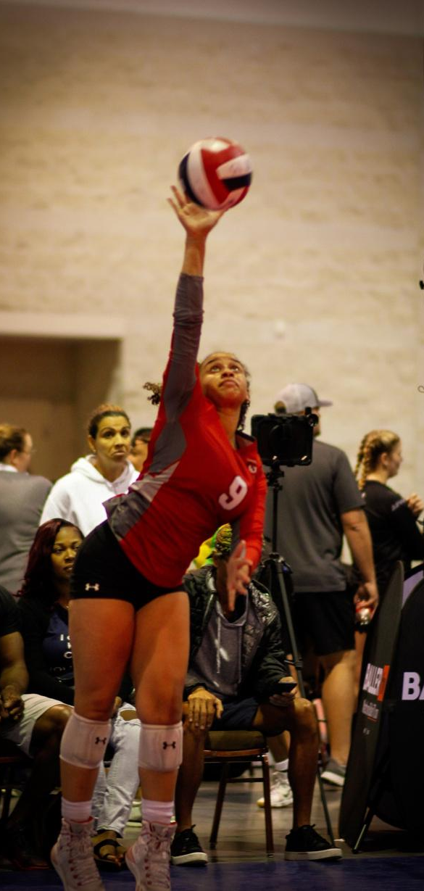
FLORIDA JUNIORS POWER LEAGUE
LEAGUE MISSION
Mission
To create a competitive environment throughout the season at the lowest possible cost.
To enhance the tournament experience for athletes, parents, coaches and directors.
To establish a tournament schedule that ensures quality and competition year after year.
To promote the local clubs and their athletes.

Slide 3
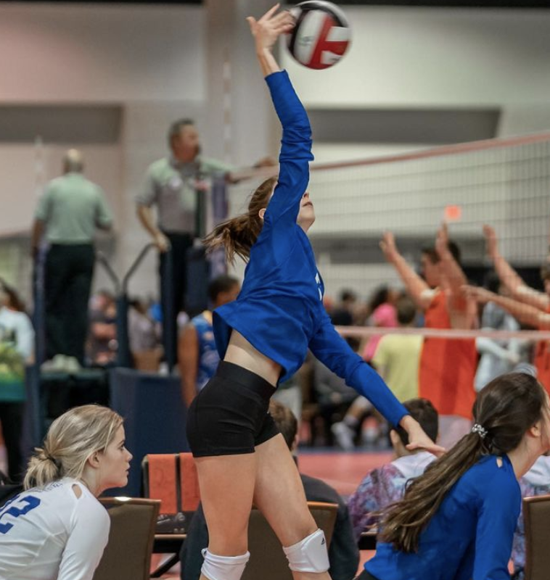
FLORIDA JUNIORS POWER LEAGUE
PARTICIPATION
In order to participate, be ranked, and win the Power League:
Participate in initial ranking event (December Winter Warmup)
Play in two of the three Power Pool events (see event schedule on next slide).
Participate in the Championship Event (May Clash of Champions.
Teams that do not meet these criteria, but still play in the “power league divisions” at events, will not be ranked nor able to play for the power league Championship at the end of the season.

Slide 4
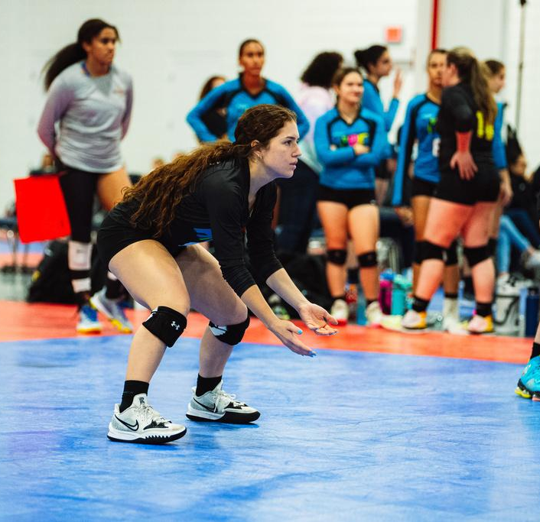
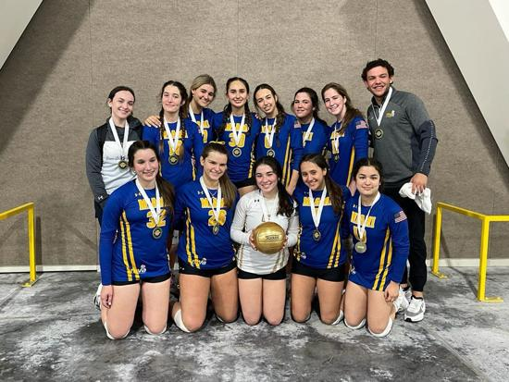
FLORIDA JUNIORS POWER LEAGUE
TOURNAMENT SCHEDULE
Mandatory Events
**December 9 - 10, 2024 Winter Warmup** - Ft. Lauderdale CC
Teams must participate in this event in order to be initially ranked within the power league. This event is mandatory for ALL teams wishing to play in the Power League.
**May 18-19, 2024 Clash of Champions - Ft. Lauderdale CC
This event will serve as the power league finals.
Additional Events (Teams must participate in two out of the following below)
January 20-21, 2024 Tamiami Open - Tamiami Fairgrounds
February 3 - 4, 2024 FL Frenzy - Miami Beach CC
April 27-28, 2024 Spring Bash - Ft. Lauderdale CC

Slide 5
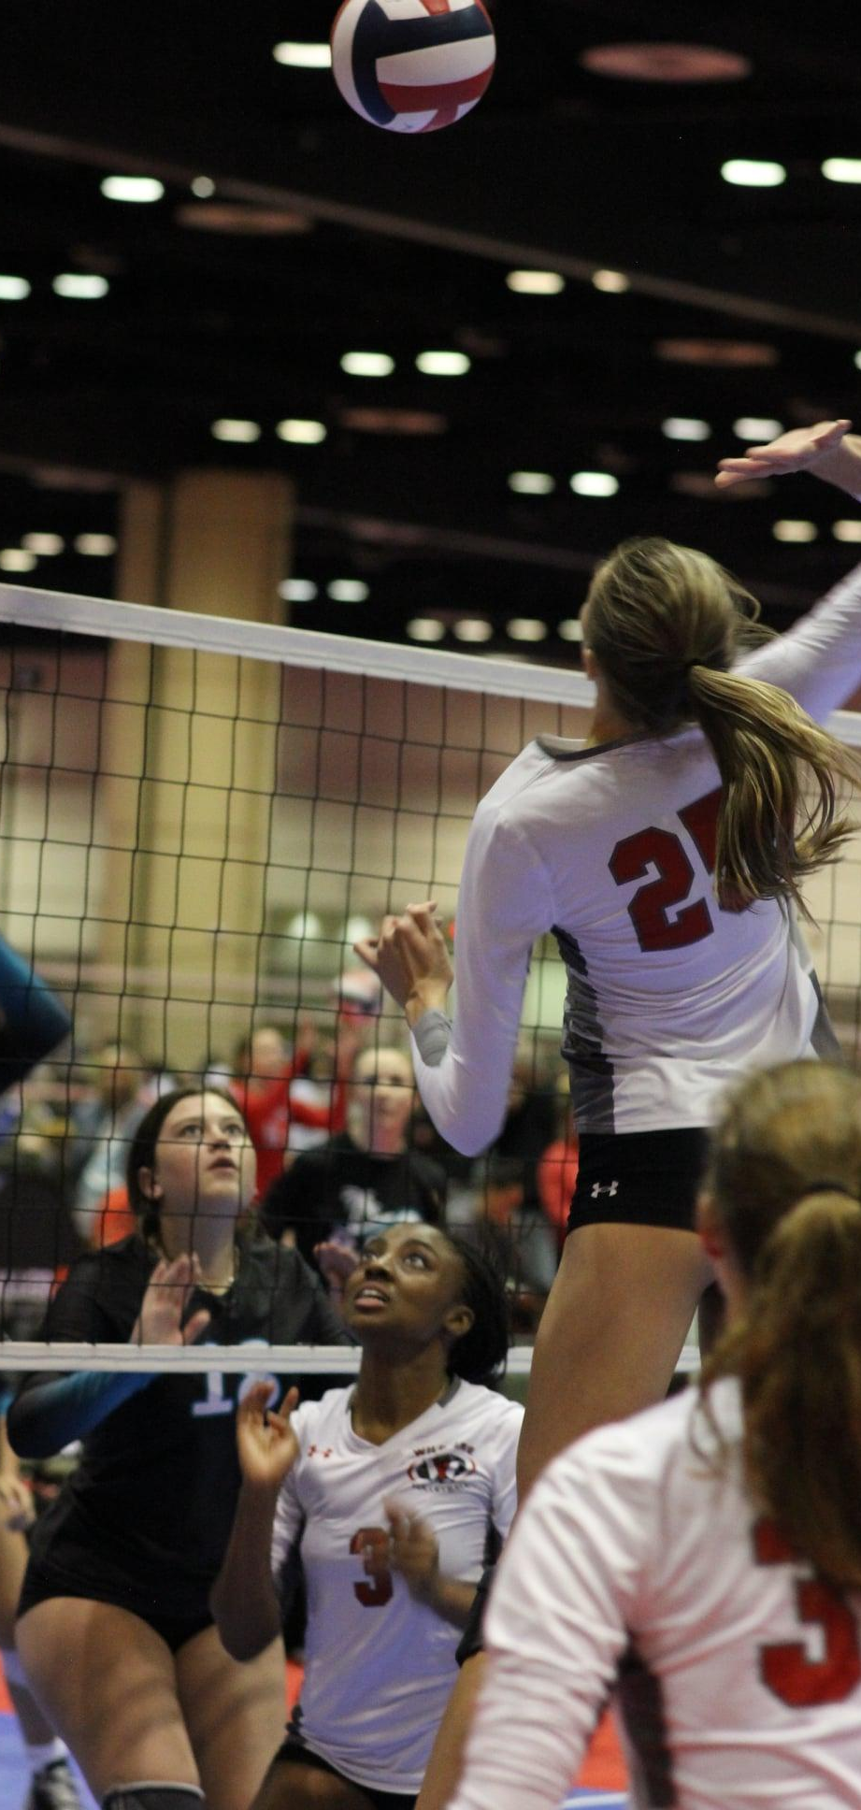
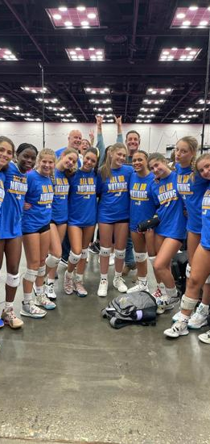
FLORIDA JUNIORS POWER LEAGUE
LEAGUE FORMAT
This series will have a ranking event, 3 Power Pool ladder events, and a championship event.
There will be a overall ranking maintained, and an age group ranking during the season for the series.
Teams will move up and down the ladder, according to the general ranking between ladder events throughout the season.
Championship event will determine the winner of the Power League in each age group.
Power League winners are independent of the Clash of Champions event winner.

Slide 6
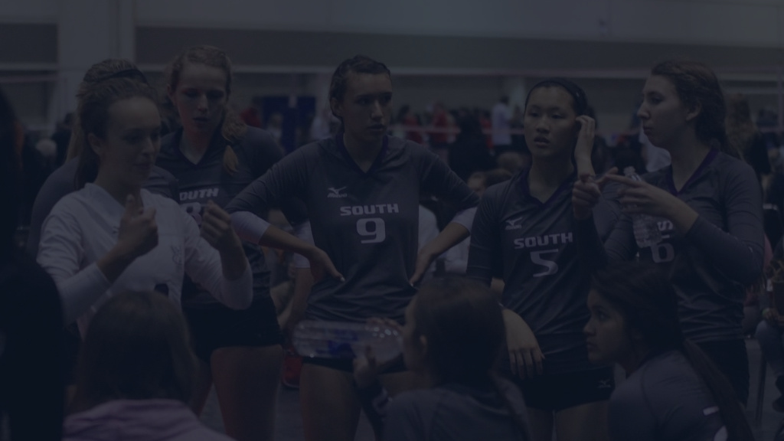
Initial Ranking Event
December Winter Warmup
BREAKDOWN
Teams play their age groups 13u to 18u
Teams play in traditional four team pool format to determine initial age group and overall ranking.
A general ranking will be formed at the conclusion of this event, starting at 1 with the winner of the 18U division and end with the lowest finishing 13U team. This ranking will updated after every event and will be used in the ladder format.
In addition, an age group ranking will be formed at the conclusion of this event and will be updated after every event but will only be used for seeding for the championship event in May.

Slide 7
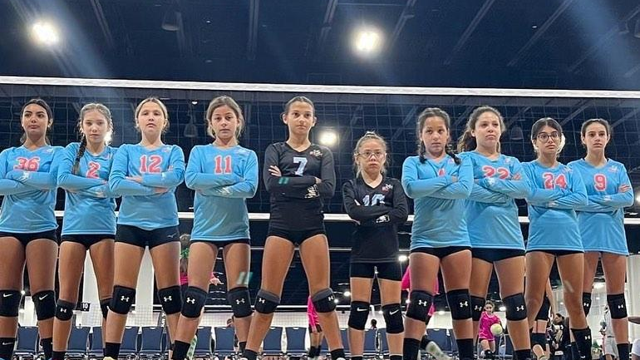
Rankings
Following the initial ranking event (Winter Warmup December), a general ranking will be formed starting at 1 with the winner of the 18U division and end with the lowest finishing 13U team. This ranking will updated after every event and will be used in the ladder format.
Teams will be Ranked from 1 - X starting with the winner of the 18U division and ending with last place in the 13U division.
For a detailed explanation of the ranking format click here.
Power League Teams will not be penalized for missing events, however they will move down in pool assignments.

Slide 8
FLORIDA JUNIORS POWER LEAGUE
Power Pool Ladder Events
The open teams will play in power pools of 6 or 8 teams
The first 2 places will move up the ladder for the next ladder event and the last two places will move down. Movement up and down the ladder is determined by general league rankings, NOT age group rankings.
This will ensure solid competition for all teams at their respective levels, giving everyone in the pool an opportunity to win.
Teams will be ranked according to their finish in their pool.

Slide 9
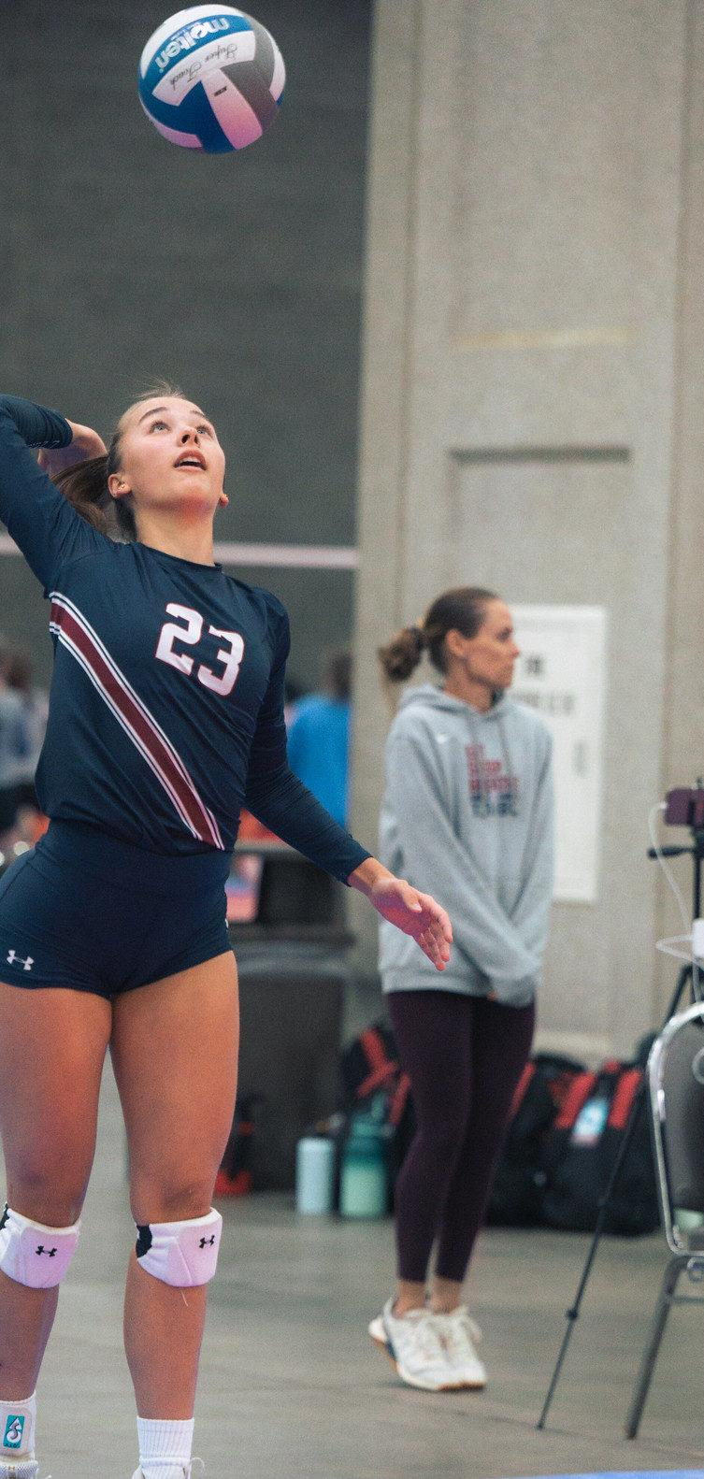
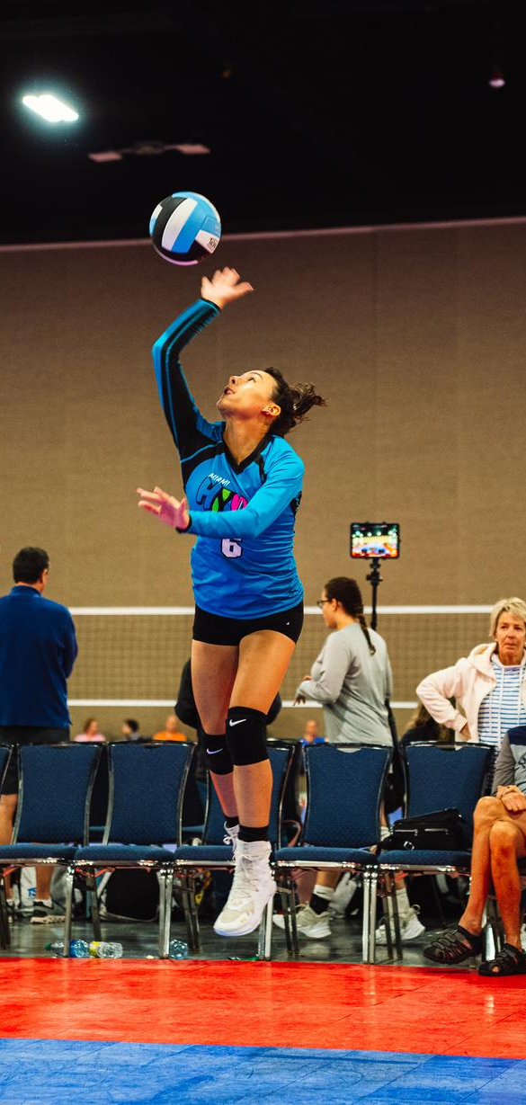
FLORIDA JUNIORS POWER LEAGUE
CHAMPIONSHIPS
CHAMPIONSHIP DETAILS
The last event (Clash of Champions) will be a championship and teams will play in their respective age groups.
This event will use the Power League age group rankings for seeding.
While any team can play and win the Clash of Champions event; only teams participating in the Power League can win the Power League Championships.
The awards for the league will be presented at this event and will be only be dependant on overall power league performance.

Slide 10
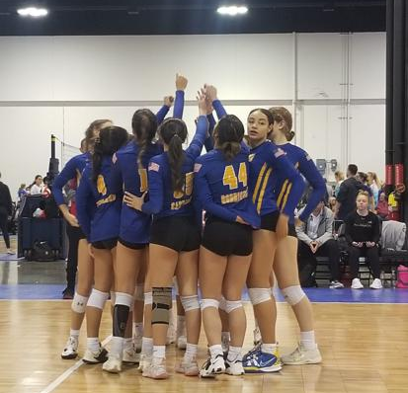
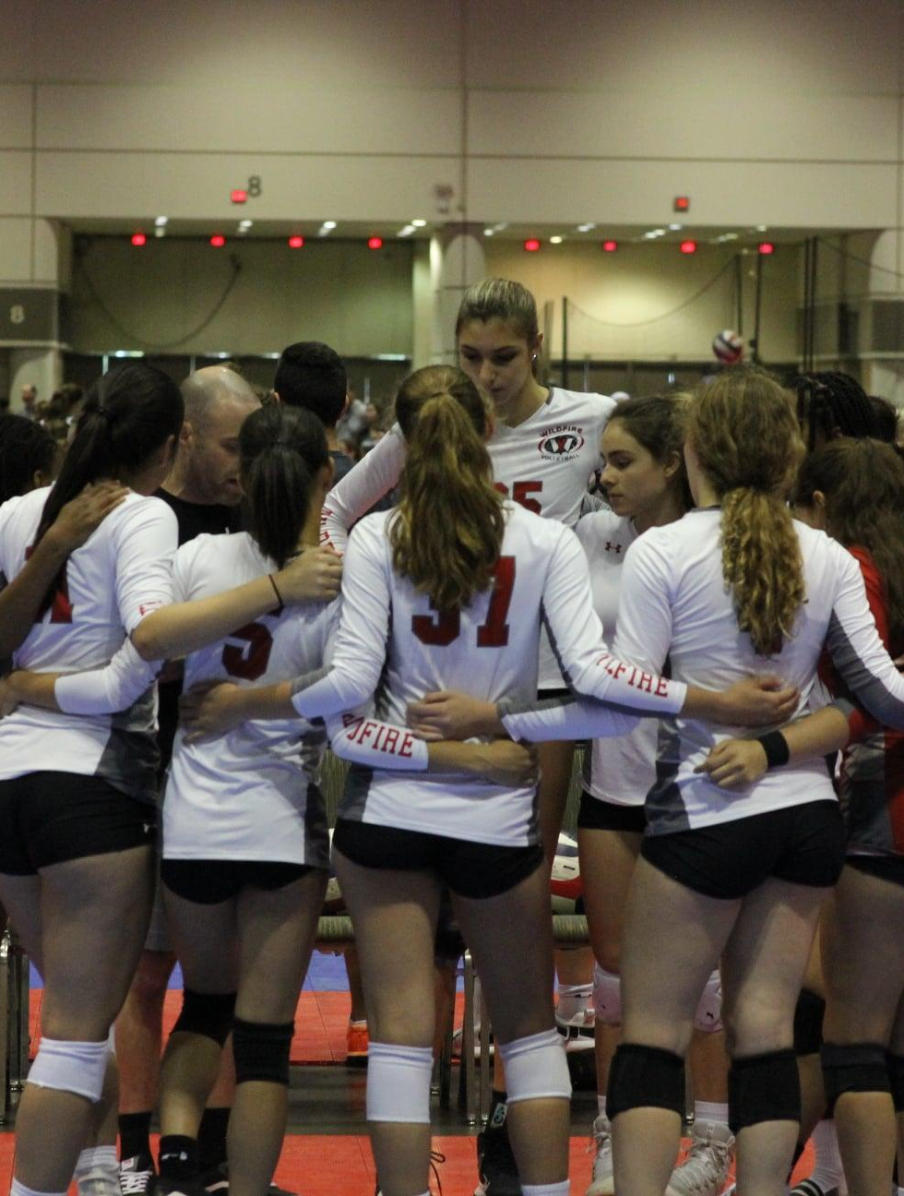
FLORIDA JUNIORS POWER LEAGUE
AWARDS
Power League awards will only be presented after the Clash of Champions event in May.
All other events will have the following awards structure:
First Place thru Third Place awards

